Slide 1
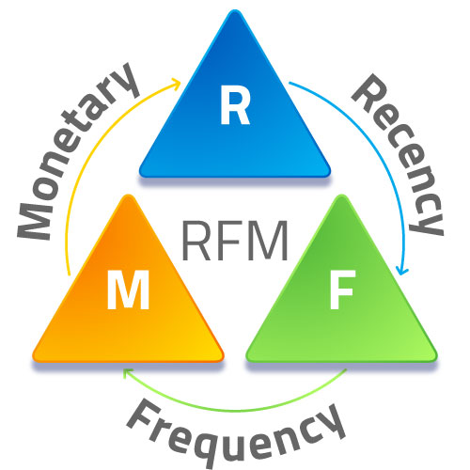
Marketing Analytics- RFM Analysis

Slide 2

Objective
Segment the "Purchases" dataset based on Recency, Frequency, and Monetary scores, and provide targeted marketing recommendations for the identified customer segments.

Slide 3
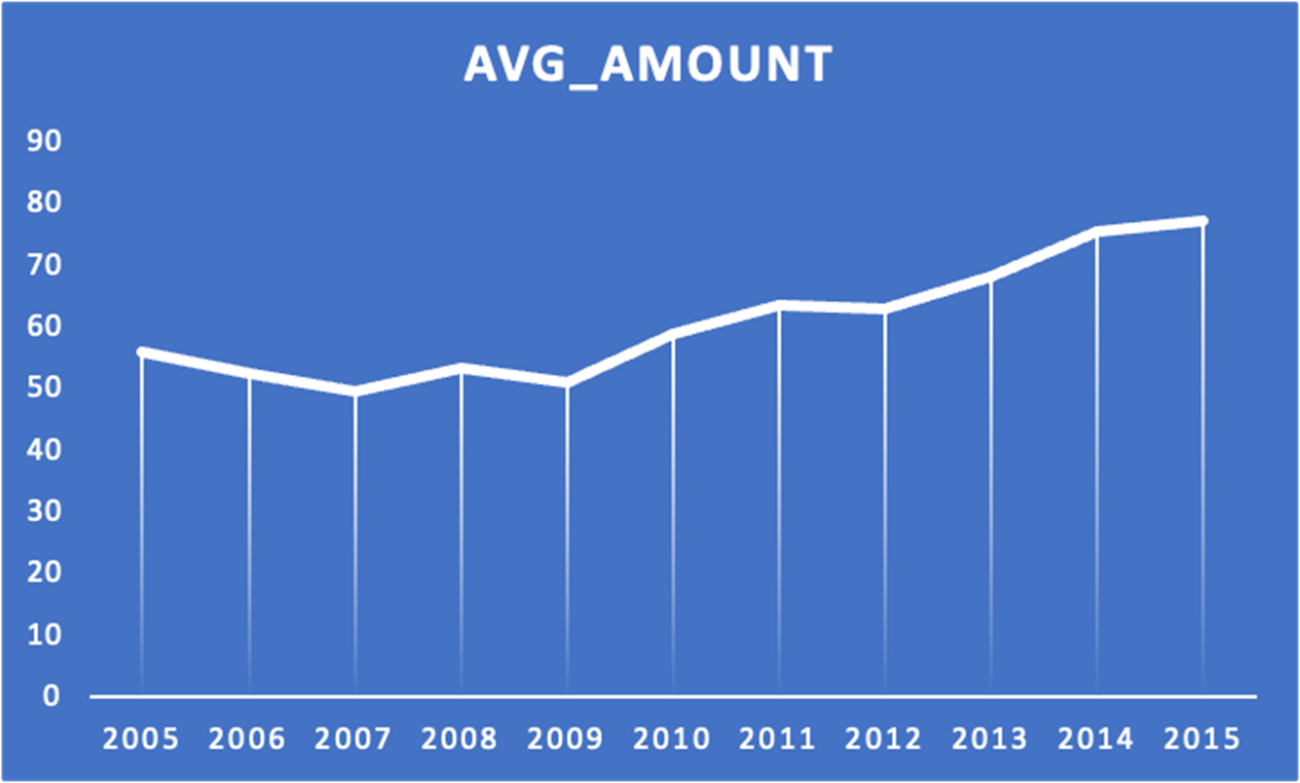
Exploratory Data Analysis
Transaction Details of the Retail Shop from 2005 – 2015
No of Transactions: 51243
No of features: 3
Variables in the dataset
Customer ID
Bill Amount
Transaction Date
3

Slide 4
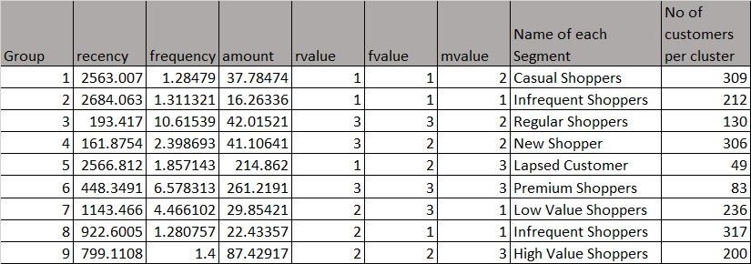
Hierarchical Clustering Segments
As per the transformed data we have 9 clusters which are given through recency, frequency and monetary.
We see the number of customers in each cluster

Slide 5
RFM Score Calculation
Score | 1 | 2 | 3
Recency | Day>1095 | 365>Days<1095 | Days<365
Frequency | 1 | 2 | 2+
Monetary | Amount<28 | 28<Amount>44 | Amount>44
R Score*100 + F Score*10 + M Score= RFM Score

Slide 6

Segments To Target
High Recency , Moderate Frequency and Moderate
Monetary: RFM Score= 322 (Newbies)
Recent visitors who make occasional purchases, spending a substantial amount, and have completed transactions 2.
Total Customers in this segment : 306
High Recency, High Frequency and High Monetary: RFM
Score = 333 (Exclusive Elite)
Recent visitors are frequent and make high-value purchases, with transactions exceeding 3.
Total customers in the segment : 83

Slide 7





Marketing Actions
Newbies
Exclusive Offers to be given
Discount Offerings on next purchase
Engagement Campaigns
Exclusive Elites
VIP Access
Personalized Communications
Surprise Gifts or Bonuses
Exclusive Loyalty Rewards

Slide 8
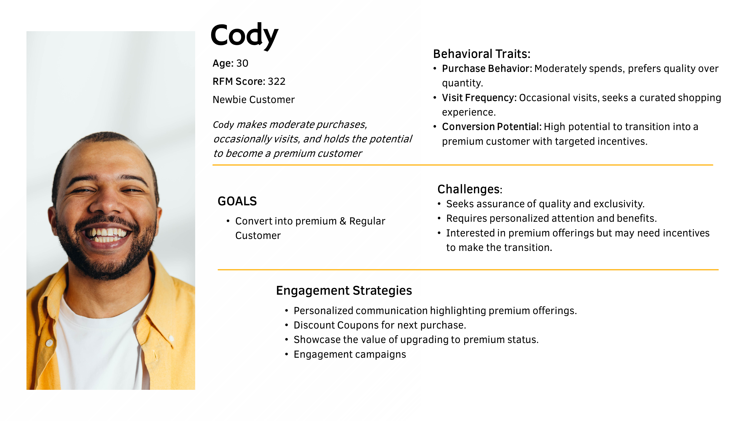

Slide 9
